Slide 1
Using an unsupervised Machine learning algo to predict the next great city to move to
Group 4 – “Dave’s Eagles”
Andrew Gerashchenko, Lucy Green, Natasha Nelson, Stephen Pozzuoli & David Supple

Slide 2
ABOUT the project
We plan to use K-Means clustering to explore anomalies within the data. Our goal is to find cities where real estate may be ready to boom.
We heavily utilized Python, Google Collab, Postgres and unsupervised machine learning to develop our data.

Slide 3
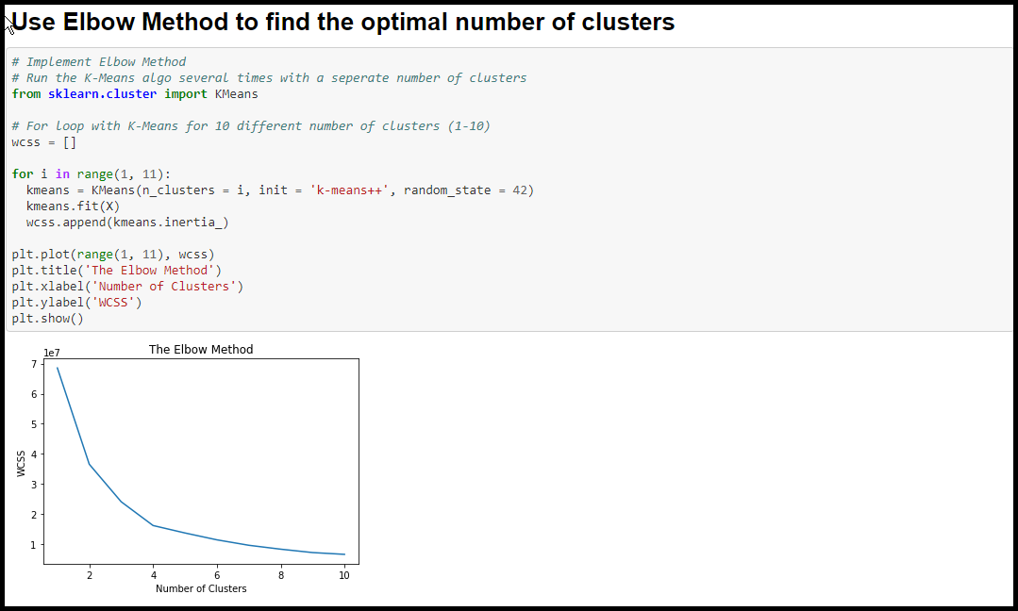
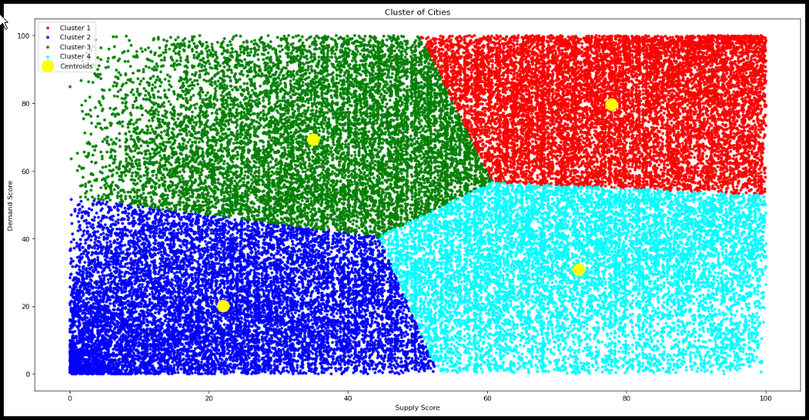
K-means clustering
Using the Elbow Curve method, we were able to determine 4 unique clusters from our data set.
After running the clustering model, it displayed 4 distinct clusters for us to explore.
Using these clusters, we attempted to find the correlations between the data and what caused the cities to be clustered the way they did.

Slide 4
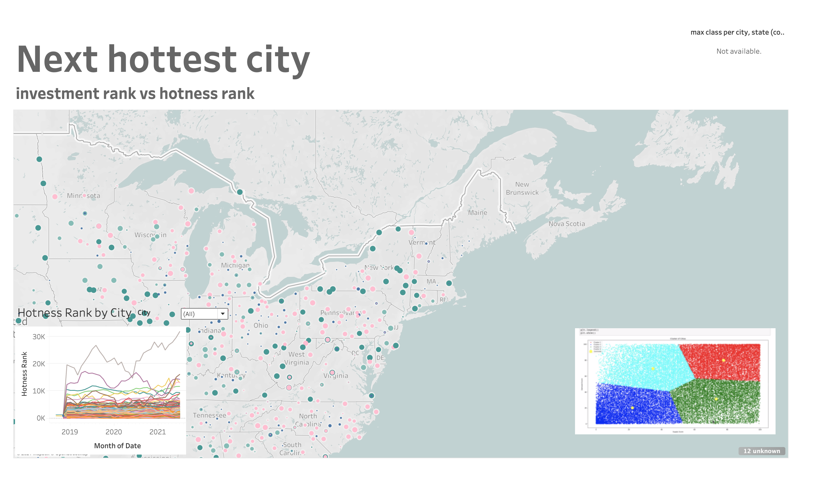
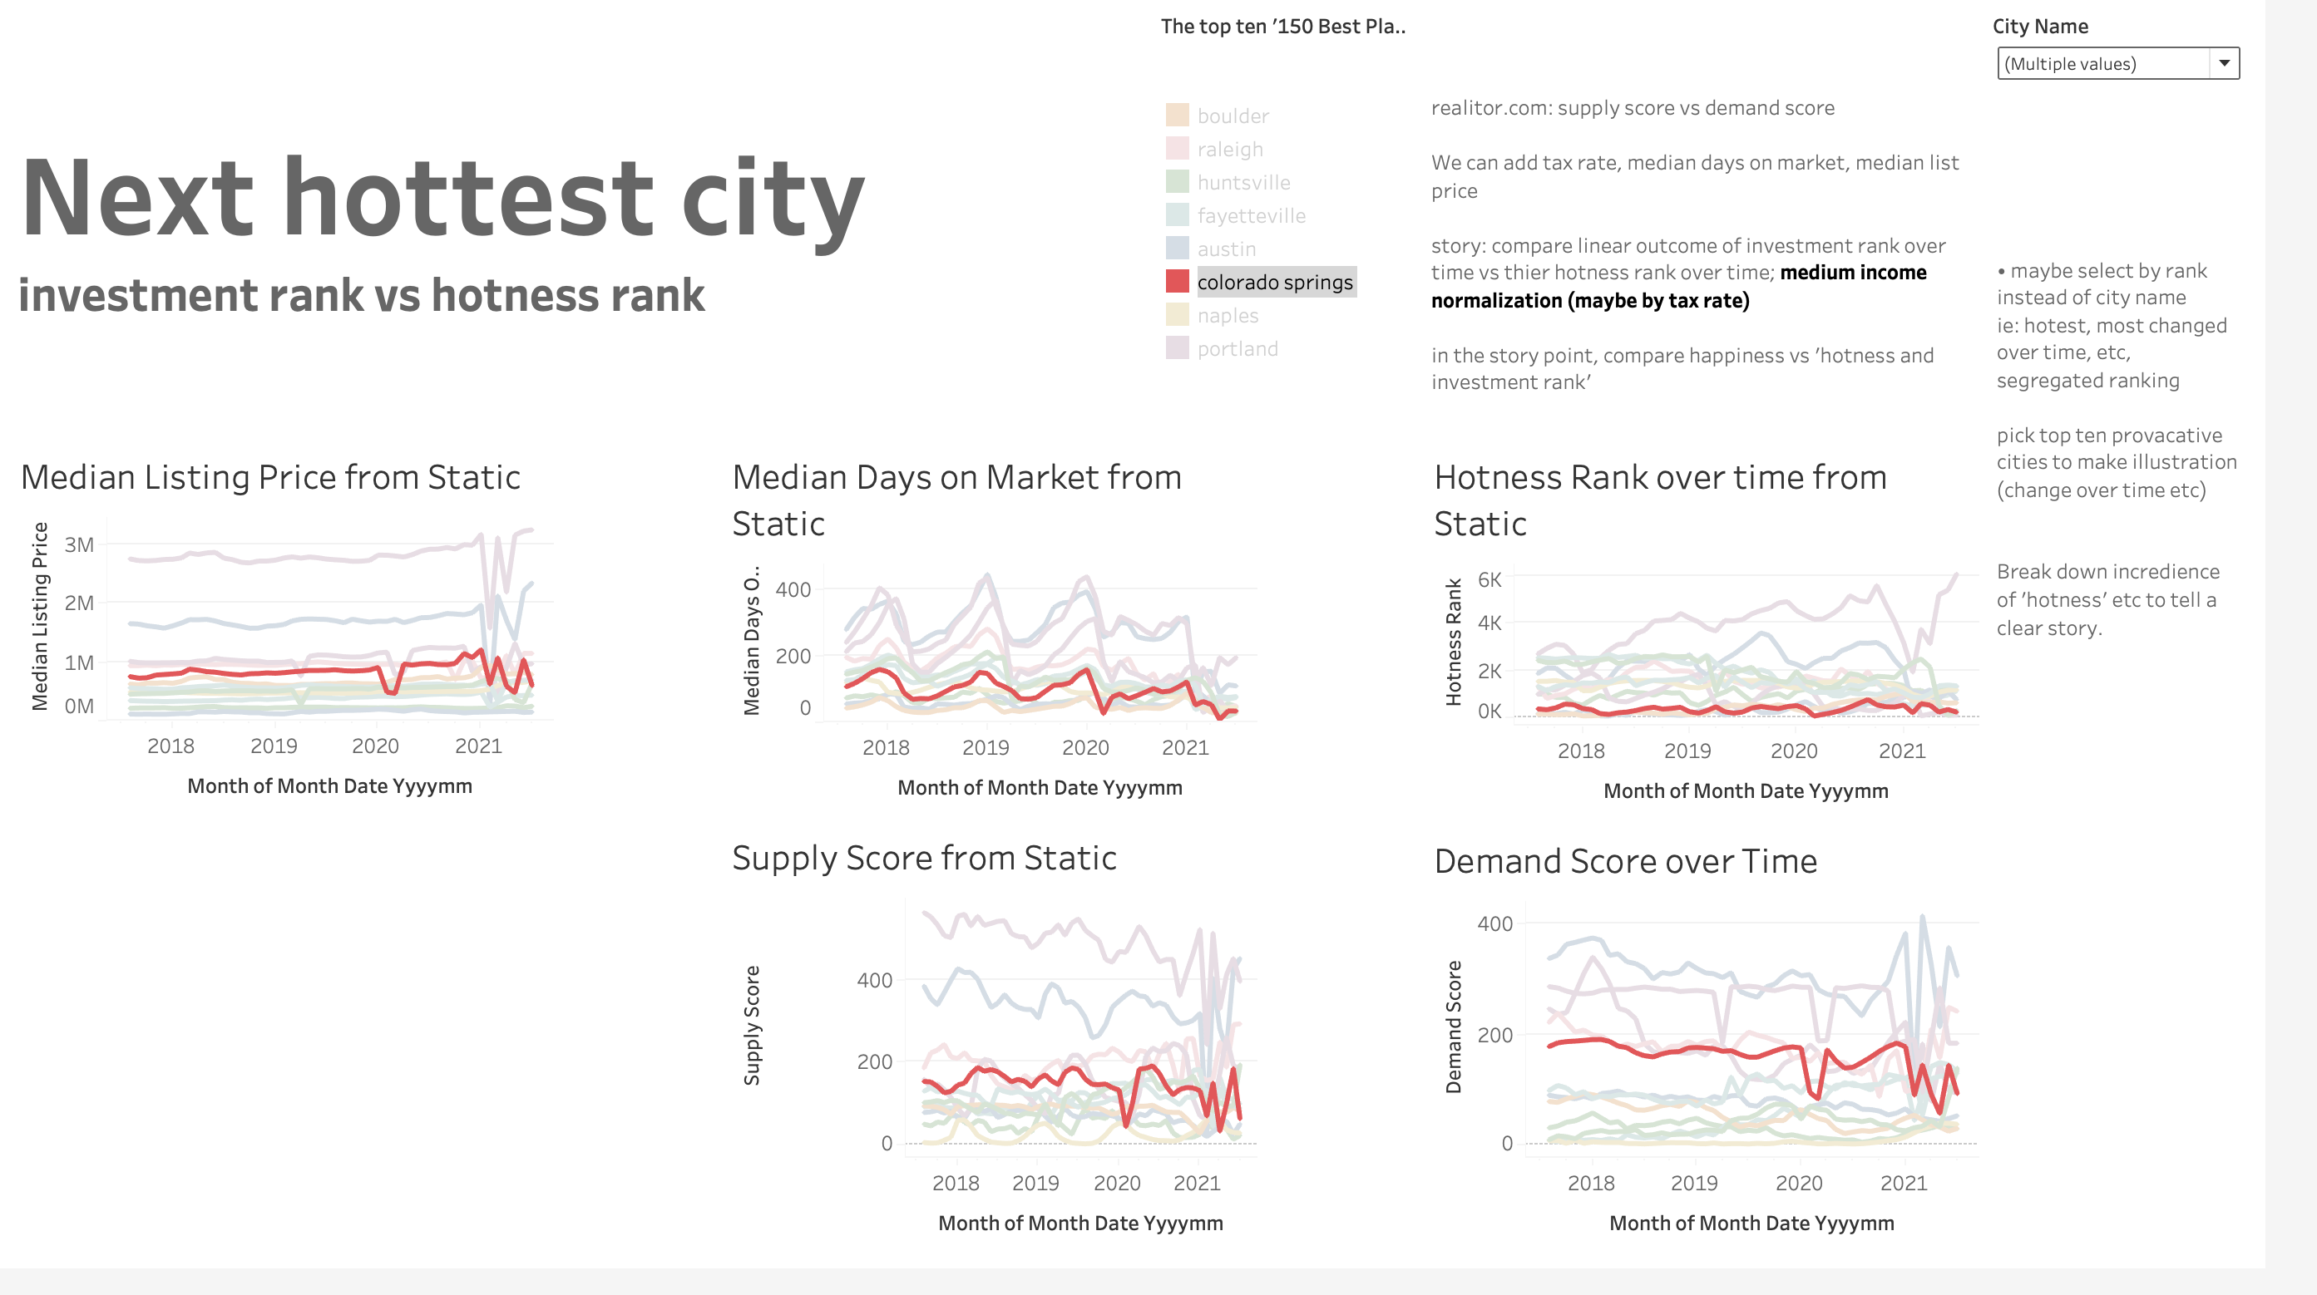
Dashboard tools
Tableau will be a key element of the image process we hope to deliver on our dashboard. Examples of some that we have created already are here.

Slide 5
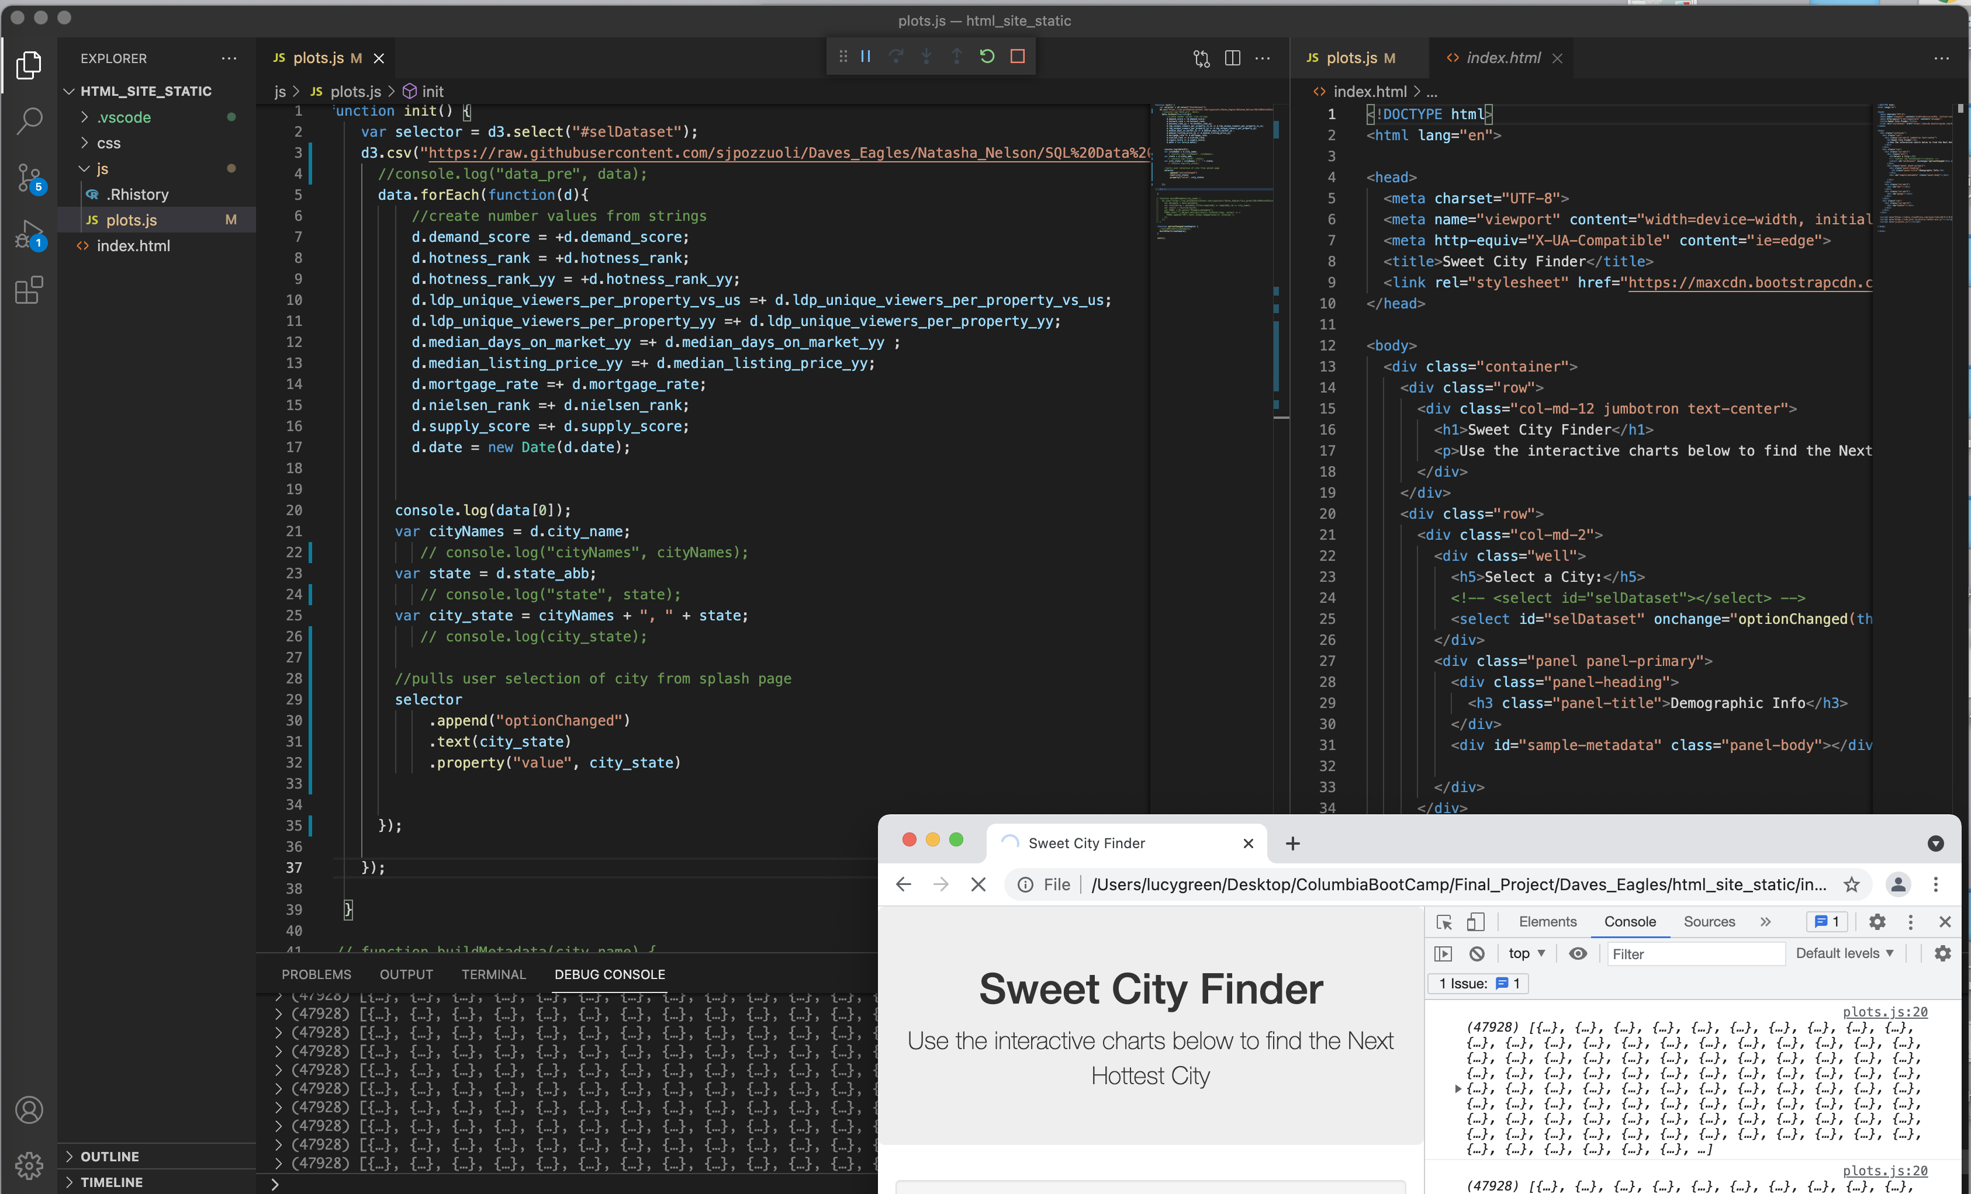
Interactive elements
We are in the process of building an interactive website for the user to explore using JavaScript.
Within this, we hope to utilize choice menus for the user to pick from a list of cities and see pertinent information to the project that we uncovered.

Slide 6
THANK YOU

